Slide 1


Diplomado Xamarin
Day 2

Slide 2

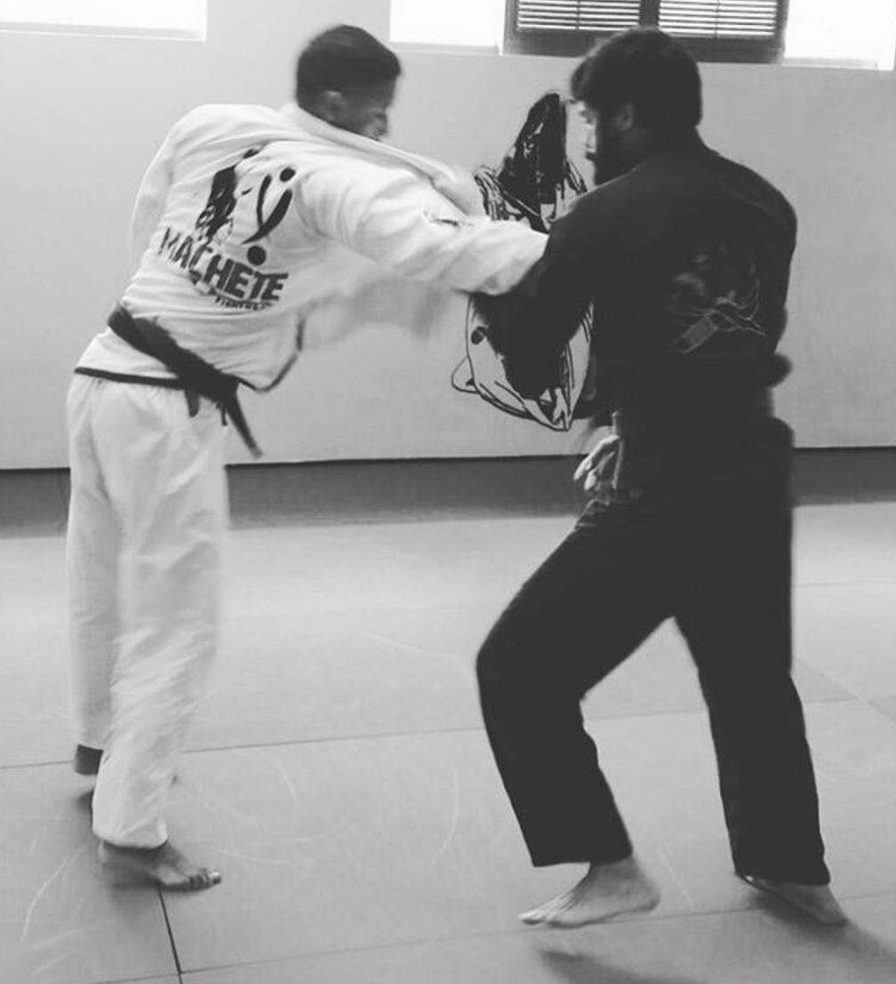


Hector Minaya
Megsoft Consulting
Email: hector@megsoftconsulting.com
Blog: https://medium.com/@hminaya
Twitter: @HectorMinaya

Slide 3

Agenda
Checklist
Xamarin Forms
MVVM Pattern
Best Practices
PRISM
Navigation
Commands
Dialog Service
Demo
Lab
info@megsoftconsulting.com

Slide 4
Before we begin - Checklist
MAC
PC
IDE
Xamarin Studio 6.2.1 or
Visual Studio for MAC Preview 5
Java
JDK 1.8.0_121
Android SDK
Android 6.0
iOS SDK
X Code 8.3
IDE
Visual Studio 2017 w/ Xamarin for Visual Studio or
Visual Studio 2015 w/ Xamarin for Visual Studio (4.3.0.795)
Java
JDK 1.8.0_121
Android SDK
Android 6.0
Mac?
If you plan on testing with iOS then you need network access to a Mac w/ X Code 8.3
info@megsoftconsulting.com

Slide 5
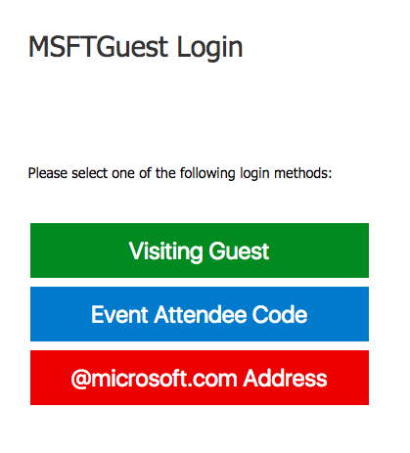
Wifi
SSID: MSFTGuest
Option: Visiting Guest
Username: user123@hotmail.com
Pass: 1856
info@megsoftconsulting.com

Slide 6
Xamarin Forms
info@megsoftconsulting.com

Slide 7
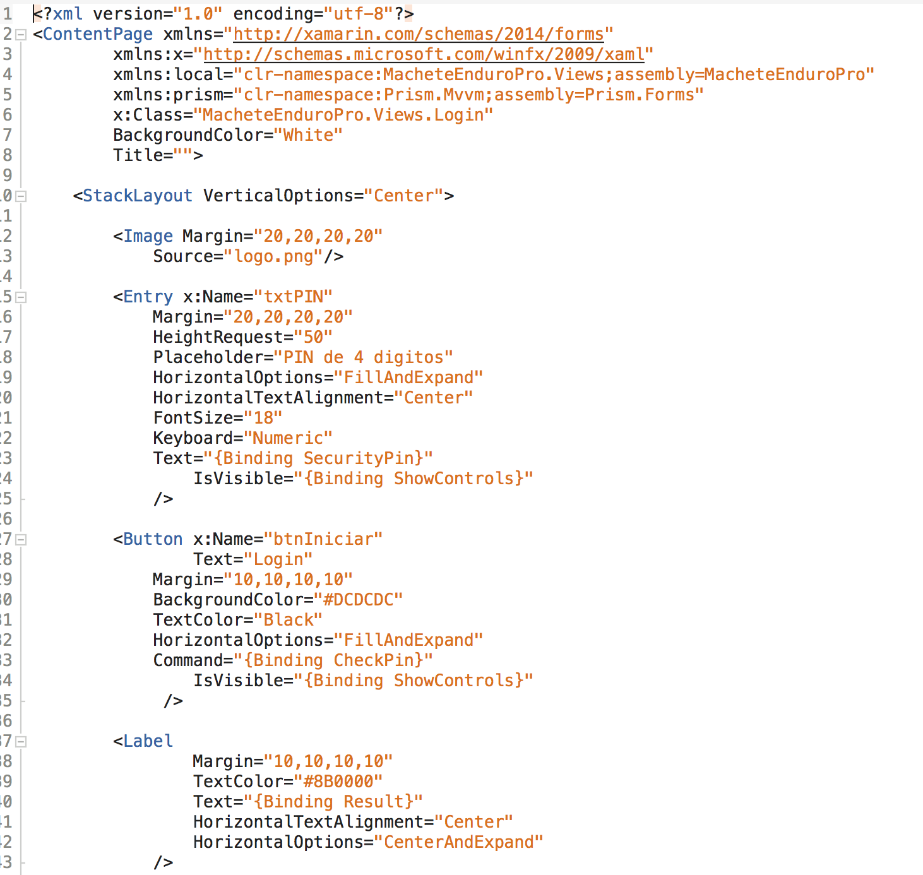
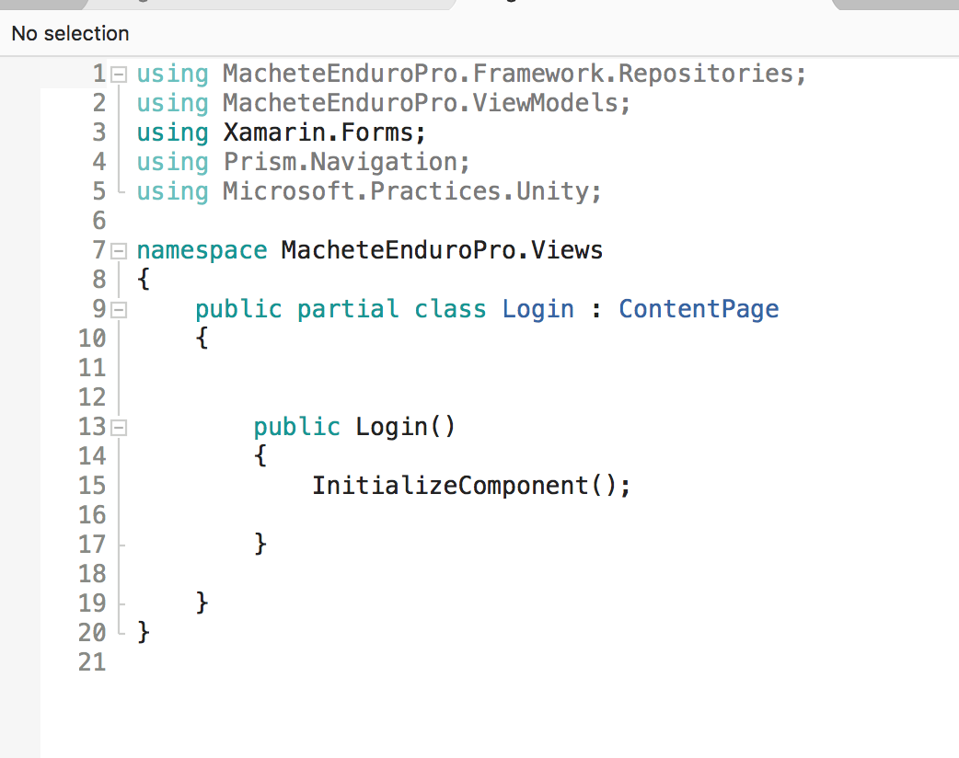
Xamarin Forms - View
CodeBehind
UI
info@megsoftconsulting.com

Slide 8



ViewModel
Binding Context
info@megsoftconsulting.com
Notes:
MVVM was introduced in 2005

Slide 9
Problems with this approach
Untestable code in the pages
No separation of concerns
Impossible IOC
Hard to maintain
info@megsoftconsulting.com

Slide 10
info@megsoftconsulting.com
Notes:
MVVM was introduced in 2005

Slide 11

info@megsoftconsulting.com
Notes:
MVVM was introduced in 2005

Slide 12



Slide 14
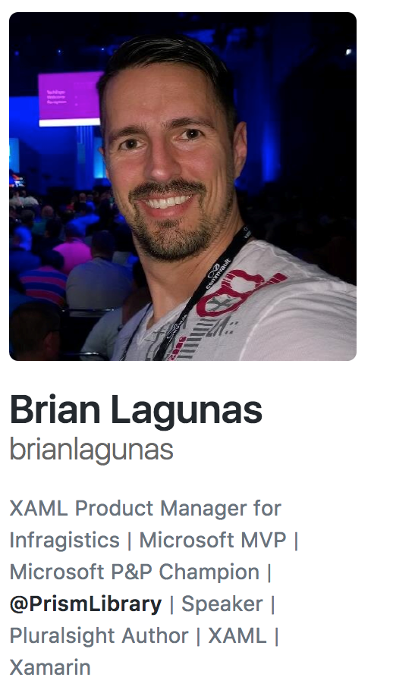
PRISM
brianlagunas.com
info@megsoftconsulting.com

Slide 15
What do we get for free?
MVVM Support
Commands
Messaging
Navigation
Page Dialog Service
Logging
Dependency Injection
info@megsoftconsulting.com

Slide 16
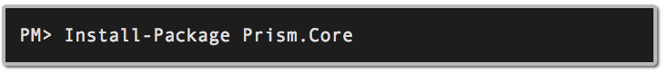
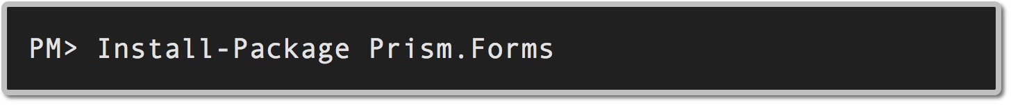
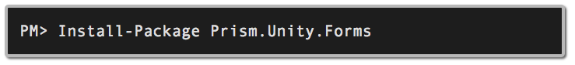

How do I get it?
info@megsoftconsulting.com

Slide 17
Convention over Configuration
info@megsoftconsulting.com

Slide 18
Convention over Configuration
Views
ViewModels
Reside in the Views namespace
Place in the Views folder
Reside in the ViewModels namespace
Should be named:
[PageName]ViewModel.cs
info@megsoftconsulting.com

Slide 19
Demo
info@megsoftconsulting.com

Slide 20
Lab
info@megsoftconsulting.com

Slide 21
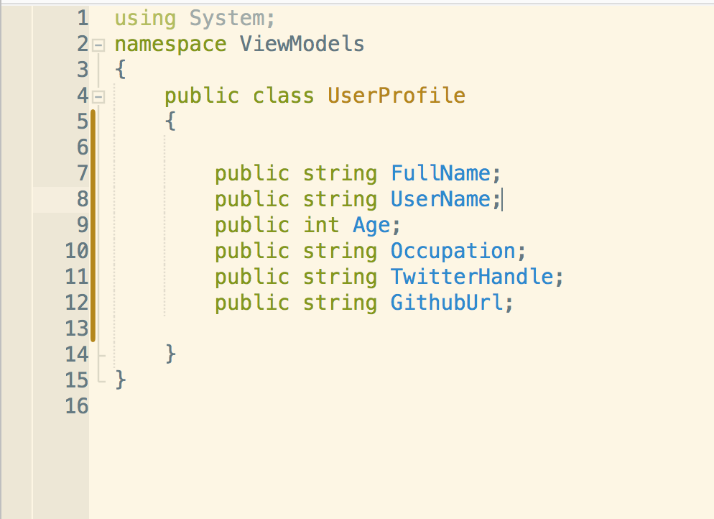
New Xamarin Forms App!
UserProfile
Edit Profile
About
Requirements
UserProfile.cs
HomeScreen
View all fields on UserProfile object
Edit button navigates to EditProfileScreen and sends UserModel
About button navigates to AboutScreen
EditProfileScreen
Edit UserProfile properties
Save button navigates back to HomeScreen and sends updated data
All fields should have valid data before navigating away
Cancel button navigates back to HomeScreen without saving data
AboutScreen
Your name, company, email
Ok button navigates back to HomeScreen
info@megsoftconsulting.com

Slide 22


